Slide 1
UX Process Template
Pertemuan 14 – Esa Fauzi – Materi Tambahan

Slide 2
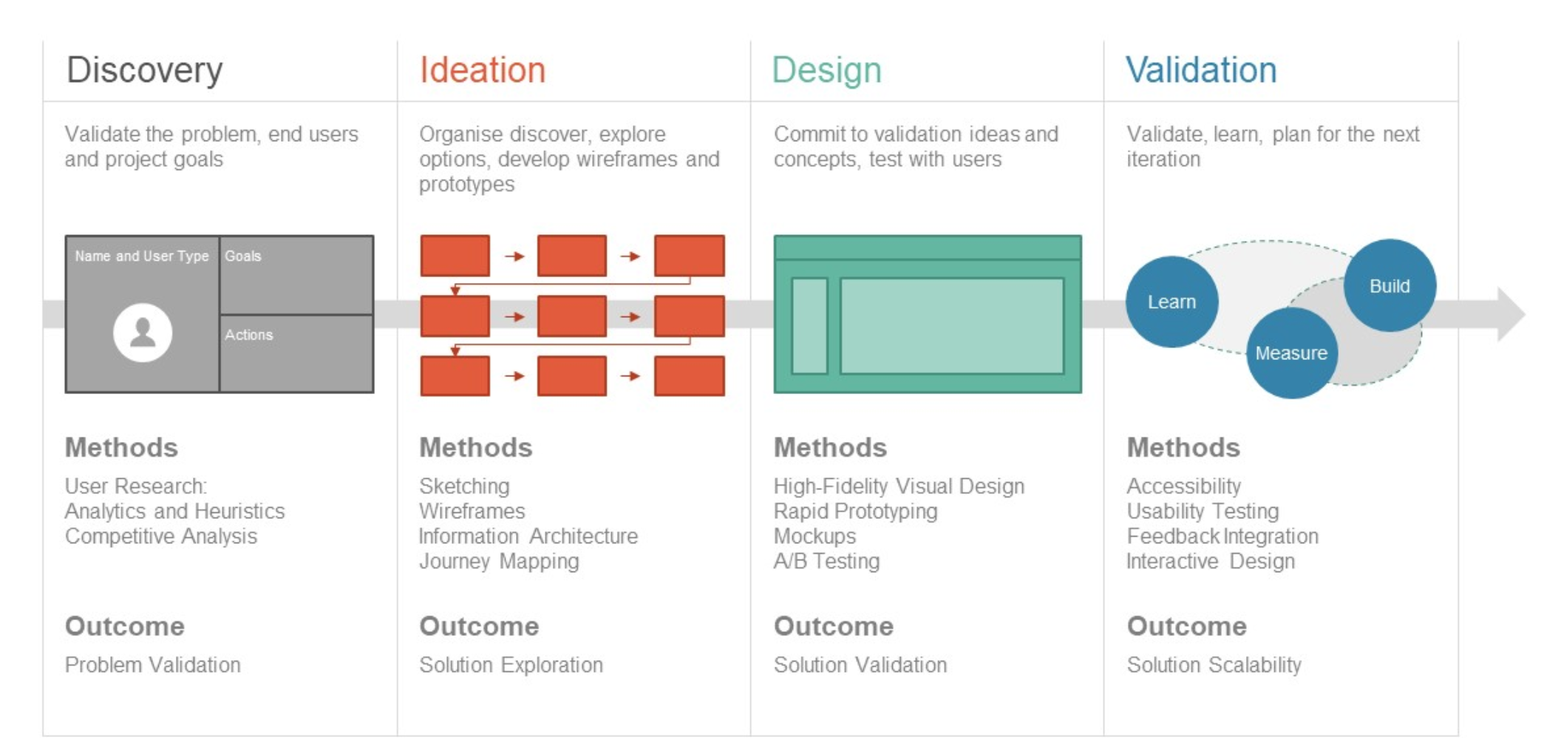
UX Design Process Template

Slide 3
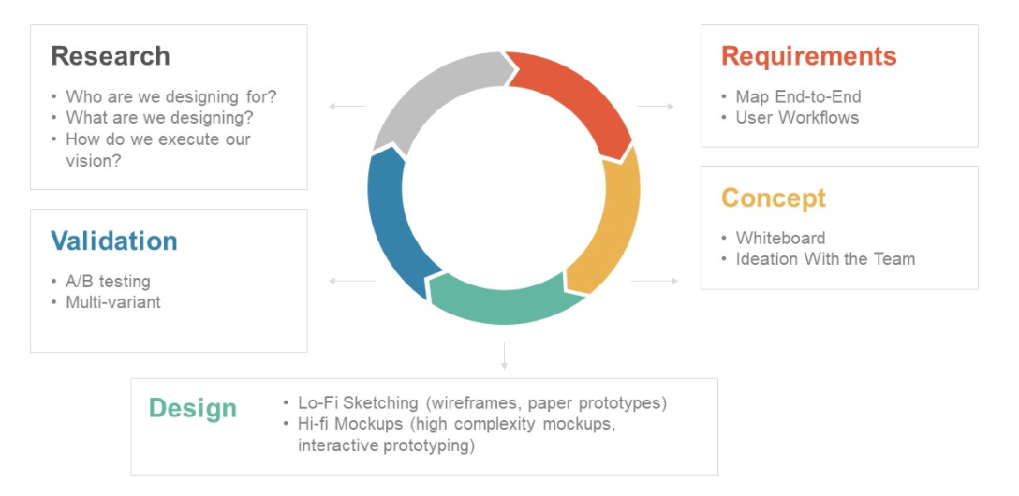
UX Design Process Template

Slide 4
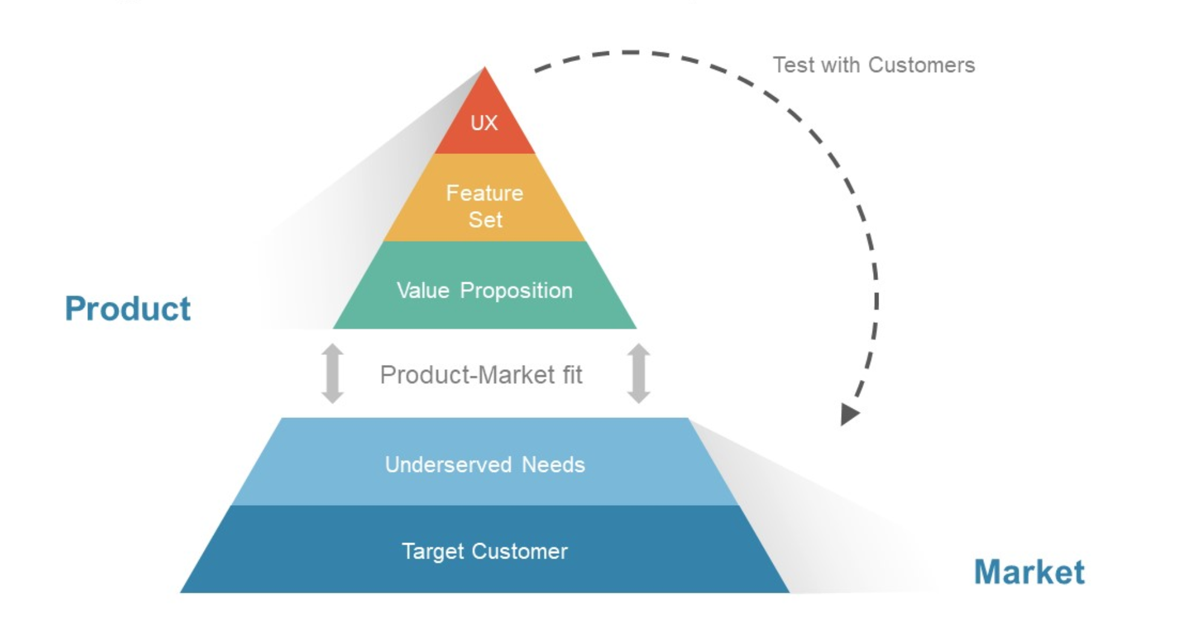
UX Design Process Template

Slide 5
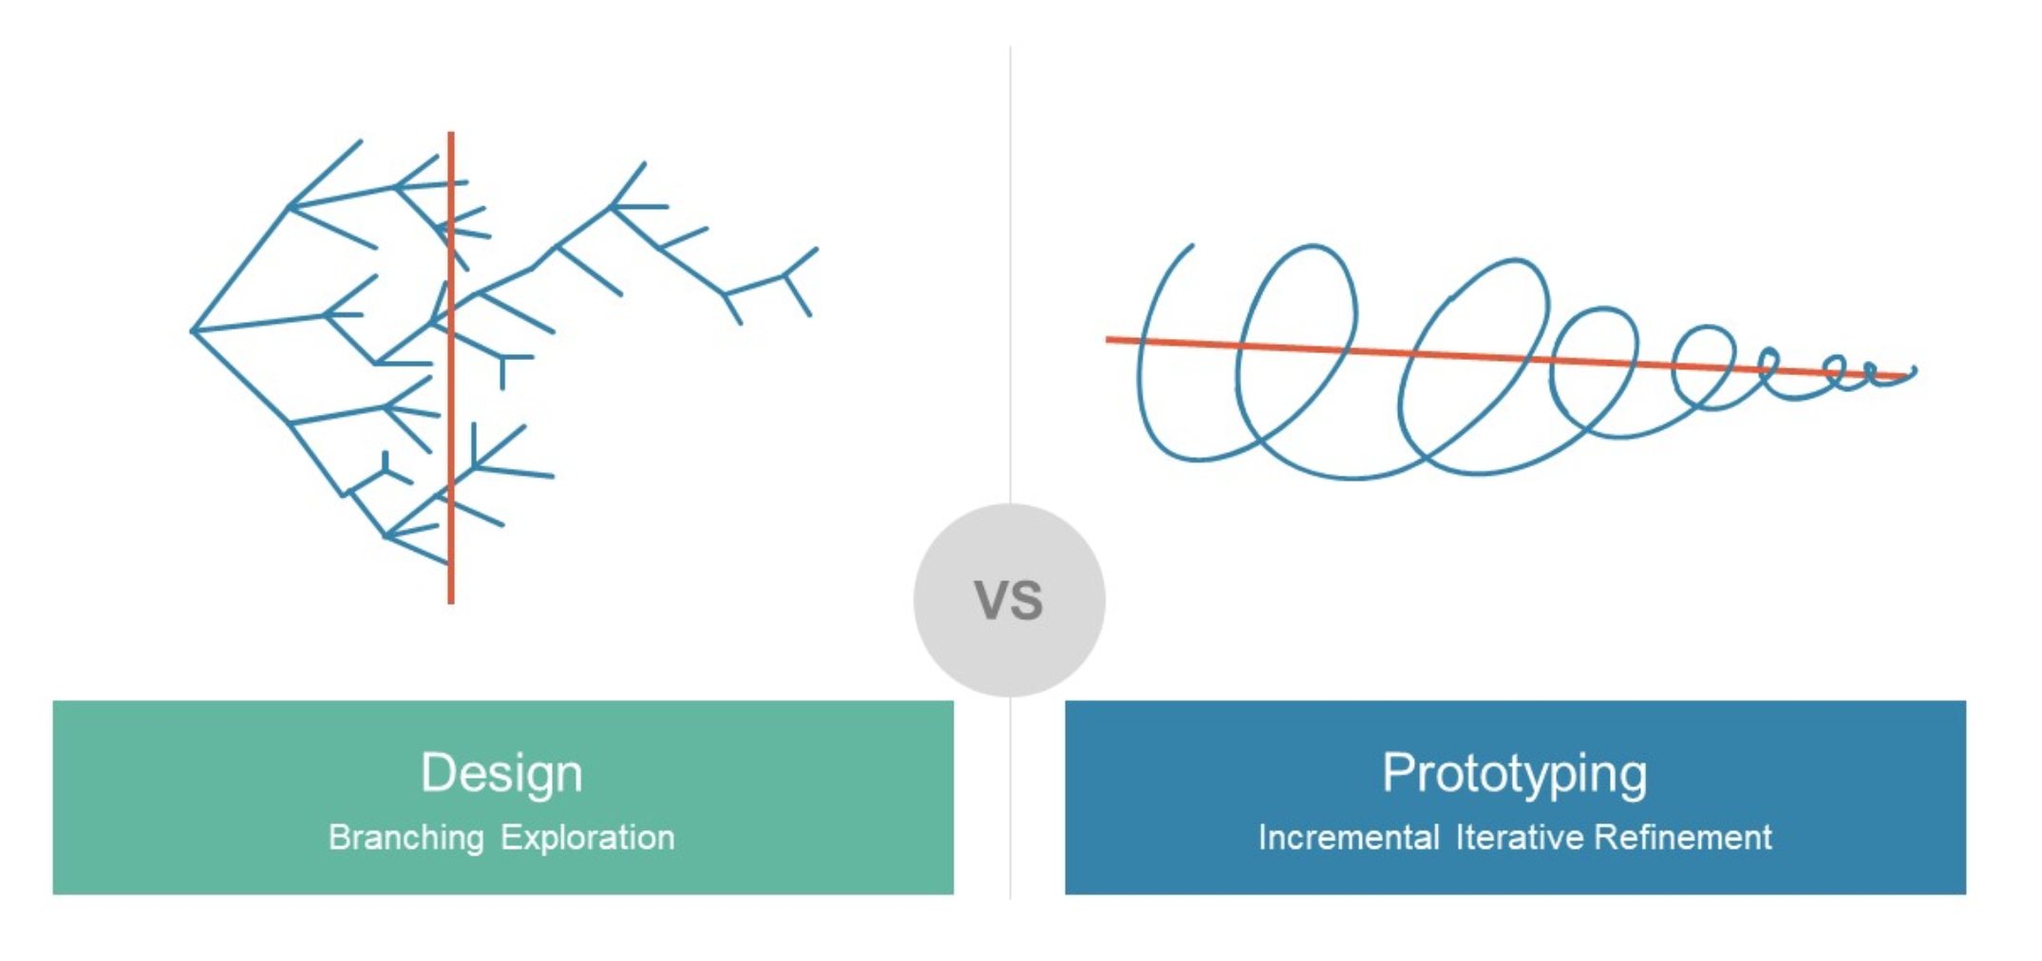
UX Design Process Template

Slide 6
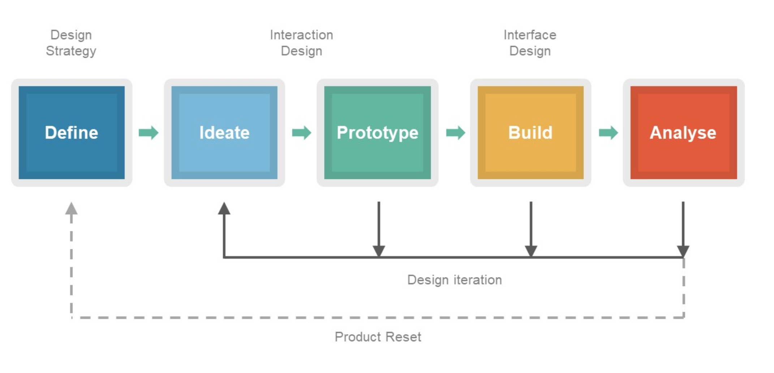
UX Design Process Template

Slide 7
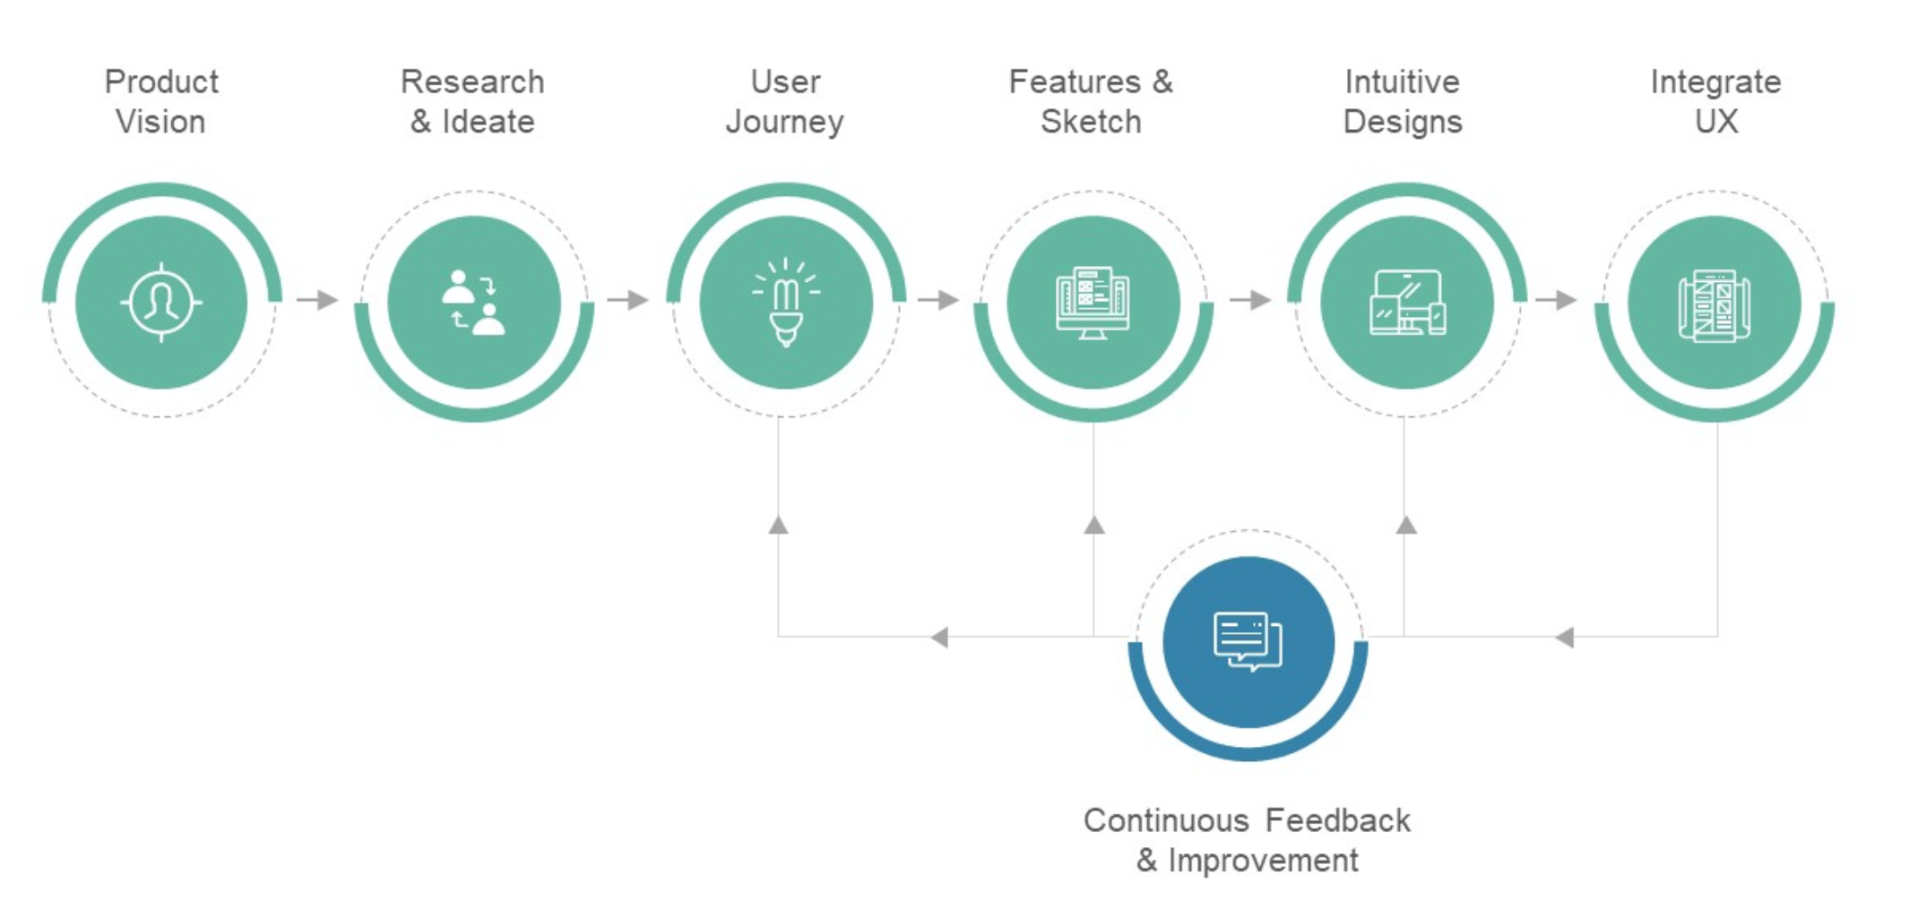
UX Design Process Template

Slide 8
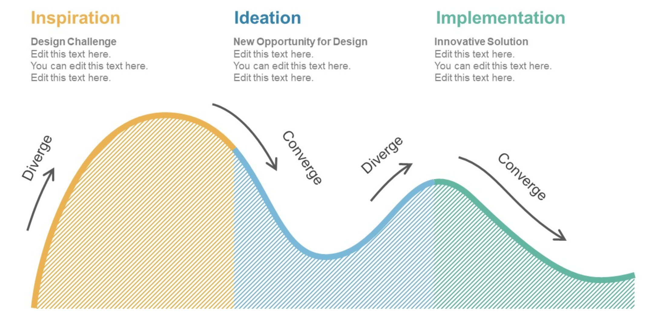
UX Design Process Template

Slide 9
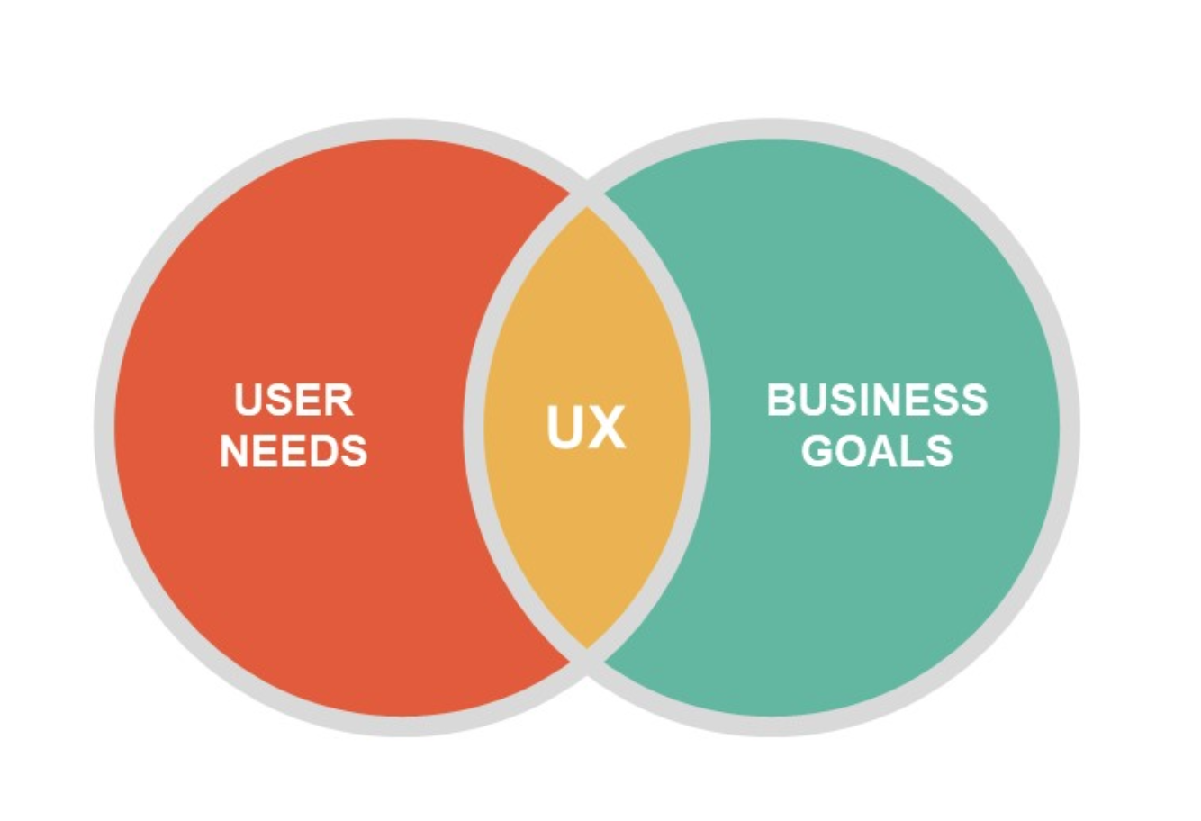
UX Design Process Template

